Slide 1
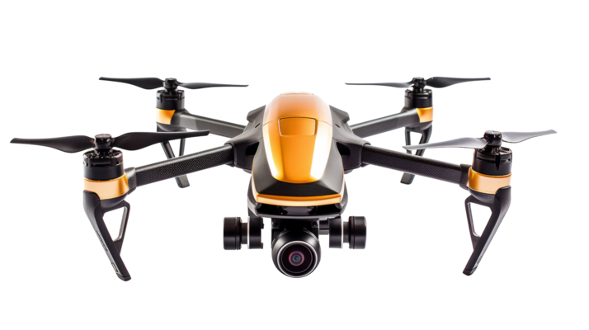
Deep Reinforcement Learning
for
Beam Management
In
UAV Relay mmWave Networks
Authors: Dohyun Kim, Miguel R. Castellanos, and Robert W. Heath Jr.
MCS PROJECT PRESENTATION
Student: FINICHIU Eduard – Adelin
FILS 1241 EB

Slide 2

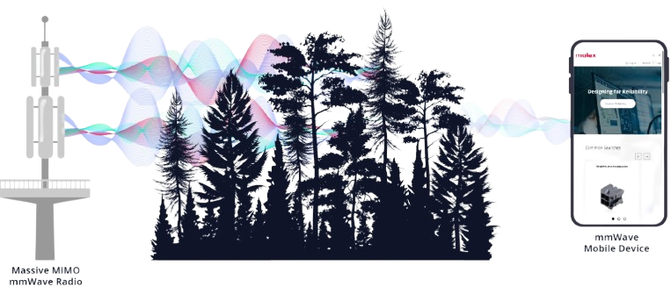
What’s the problem?
Modern wireless networks (like 5G/6G) use millimeter-wave (mmWave) frequencies to achieve very high data rates (gigabits per second).
mmWave signals have a big weakness:
* They don’t penetrate obstacles well
* They require precise beam alignment between transmitter and receiver, even small movements can break the link.

Slide 3
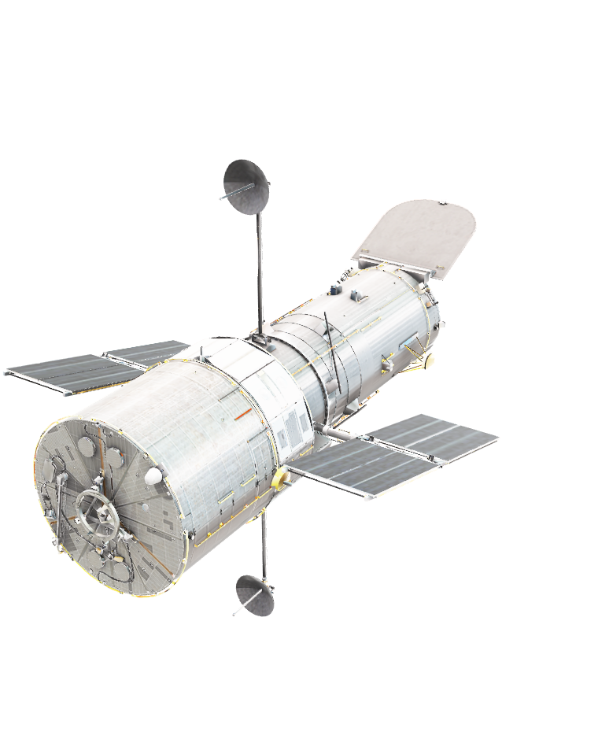
Why Use UAVs (Drones or... Maybe even bigger stuff)?
UAVs can act as aerial relays to restore line-of-sight (LOS) connections.
Useful when ground infrastructure is missing or damaged.
Provide flexible coverage in urban, tactical, or remote areas.
Challenge: each relay requires discovery, selection, and beam configuration, which adds overhead.

Slide 4
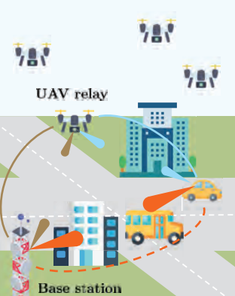
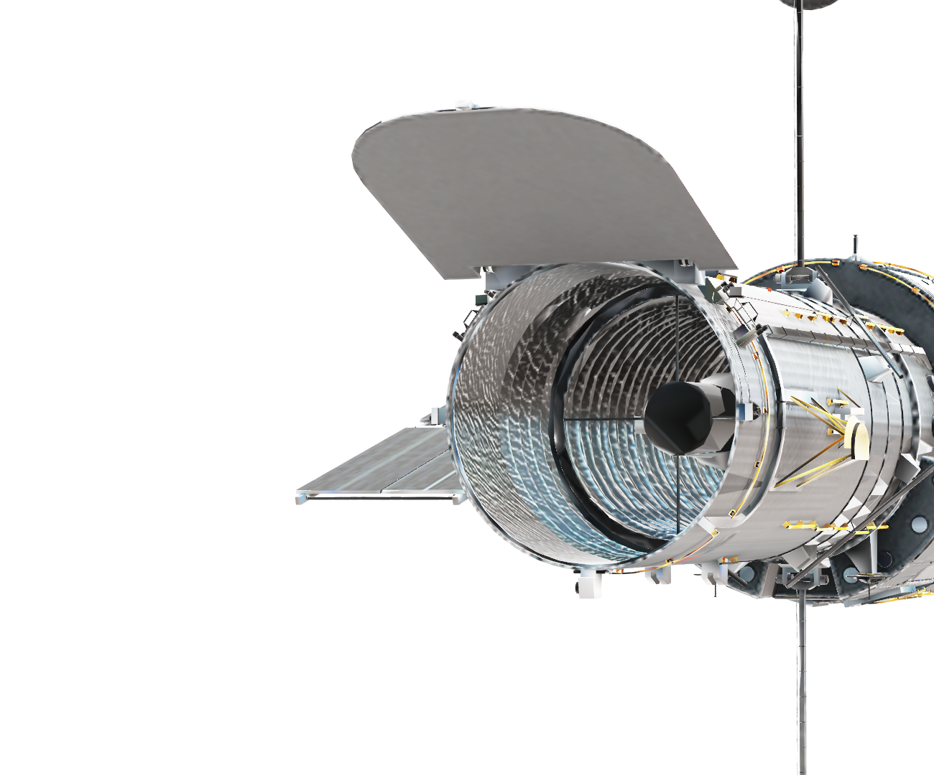
Beam Management Challenge
Beam management = discovering, aligning, and maintaining communication beams
Too little training: poor alignment → low data rate.
Too much training: wasted resources → high overhead.
Need a system that balances data transmission vs. beam alignment dynamically.

Slide 5

Deep Reinforcement Learning (DRL) Overview
DRL = learning by trial and error to maximize long-term reward.
Learns a policy: which action to take in each situation.
Components of the Markov Decision Process (MDP):
State: link qualities, beam pairs, signal conditions.
Action: transmit, realign, or switch relay.
Reward: cumulative data rate.
DRL adapts automatically to changing environments.

Slide 6
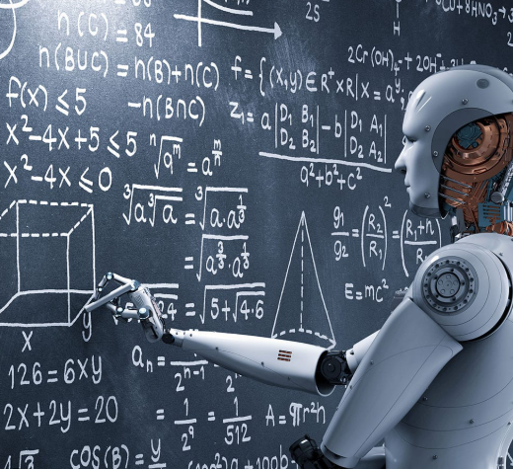
DRL in Action: Relay Selection & Beam Management
The transmitter decides whether to:
1. Continue data transmission.
2. Realign beam with current link.
3. Switch to a new UAV relay.
DRL learns thresholds that trigger alignment or switching.
Over time, it balances exploration (trying new relays) and exploitation (using the best known one).
Outcome: higher throughput with less wasted training.

Slide 7
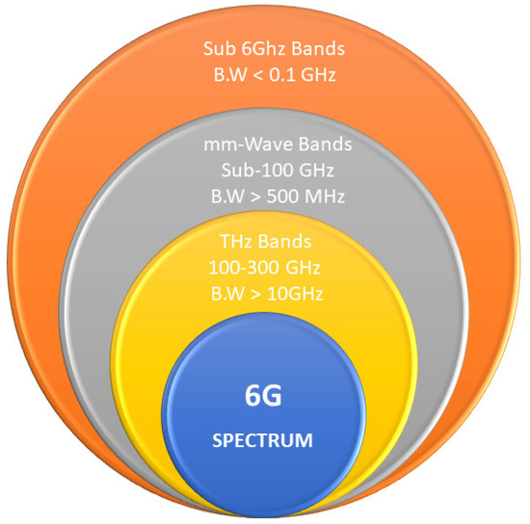
Beyond DRL: Hierarchical Reinforcement Learning (HRL
Systems can use both mmWave and sub-6 GHz bands.
mmWave: fast but fragile.
Sub-6 GHz: slower but robust.
HRL adds two levels of learning:
Upper level: choose which band to use.
Lower level: perform beam management in that band.
This divide-and-conquer structure speeds up learning and improves stability.

Slide 8
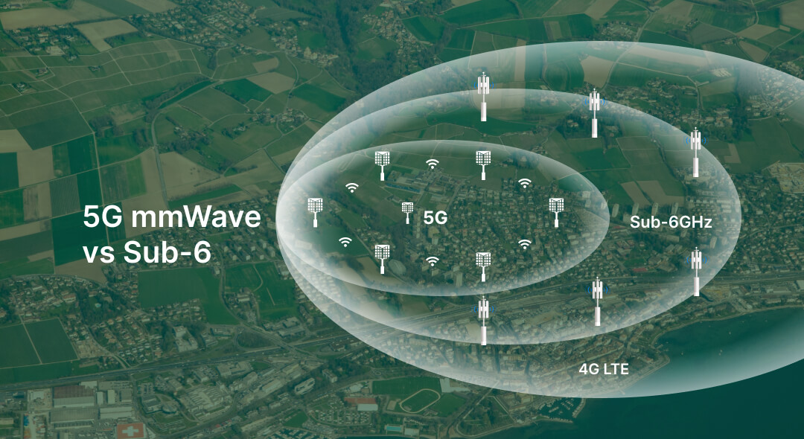

Slide 9
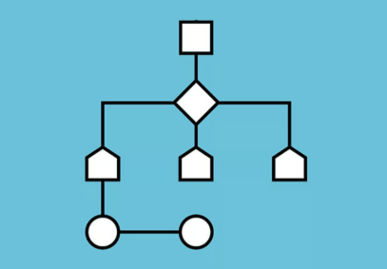
Algorithms and results
Algorithm 1: Joint band assignment + beam management using HRL.
Compared approaches:
Genie-aided (ideal case)
Static threshold (offline learning)
Direct link only
DRL & HRL methods
Results:
DRL outperforms static/offline methods.
HRL achieves faster convergence and higher rewards.
HRL reaches optimal performance in fewer training episodes.

Slide 10

Advantages of DRL/HRL Approach
Adaptive: responds to blockage and mobility changes in real time.
Data-efficient: learns from limited online observations.
Flexible: works with various UAV placements or trajectories.
Scalable: can be extended to multi-band and multi-UAV systems.

Slide 11
Future Challenges
Codebook Design:
- Reduce beam-training overhead, solve beam squint using True Time Delay (TTD) arrays.
Adaptive Arrays:
- Hardware must support nanosecond beam switching.
- Need faster, energy-efficient DRL processing.
UAV Swarms:
- Multi-agent DRL for cooperation among drones.
Limited Feedback:
- Must balance accuracy vs. communication overhead.

Slide 12
Overall Conclusion
DRL effectively handles beam management trade-offs in UAV relay mmWave networks
HRL further enhances adaptability by splitting decisions across layers.
Demonstrated higher spectral efficiency, faster learning, and robustness to dynamics.
Learning-based methods are key to future 6G and autonomous UAV networks.

Slide 13
Personal Opinion
I believe DRL-based beam management is a promising direction for future wireless networks.
The idea of AI-driven UAV relays combines two frontier technologies — robotics and 6G.
However, real-world implementation will need:
Lightweight neural networks for UAV hardware.
Reliable feedback channels and energy efficiency.
Overall, this research shows how machine learning can make communication systems self-optimizing and resilient.

Slide 14
THANK YOU!

